Slide 1
Bootstrap
ICT-Training Technical Skills

Slide 2
Introduction to Bootstrap
Bootstrap is a free and open-source tool collection for creating responsive websites and web applications.
It is the most popular HTML, CSS, and JavaScript framework for developing responsive, mobile-first websites.
It solves many problems which we had once, one of which is the cross-browser compatibility issue.
Bootstrap is a free front-end framework for faster and easier web development ·

Slide 3
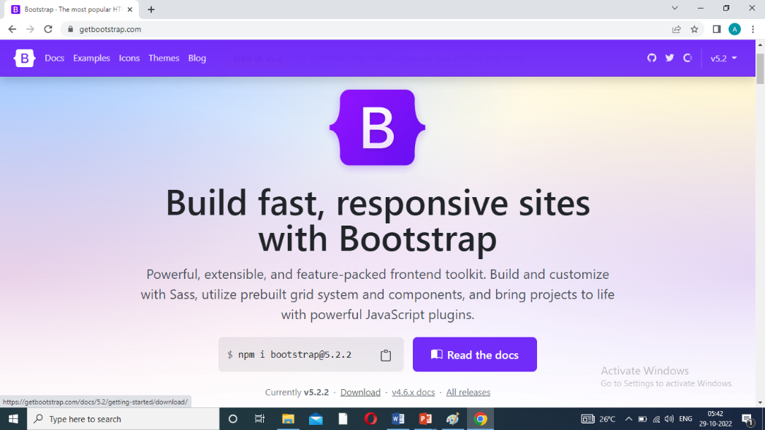
Bootstrapping the HTML webpage process
Step :1
Download Bootstrapping.
Getboostrap.com- download – bootstrap.min.css.
Bootstrapping the HTML webpage.

Slide 4
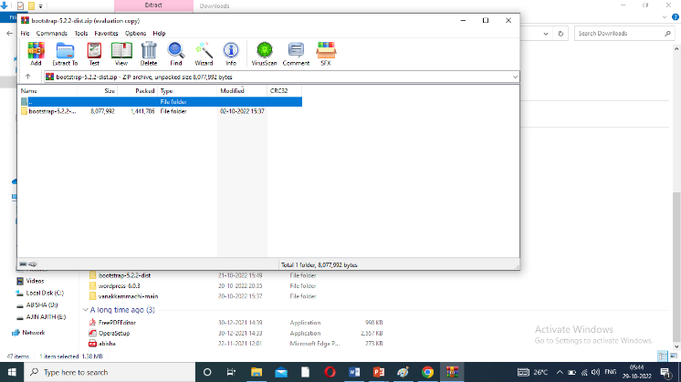
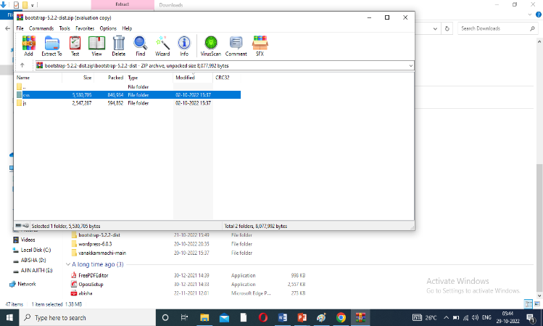
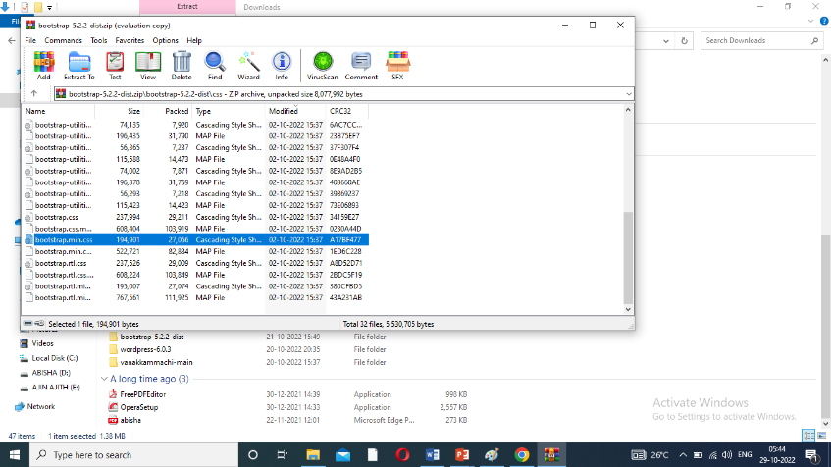
Bootstrapping the HTML webpage process
Step :2
Link to css.
Download bootstrap zip file – extract – bootstrap.min.css – copy.
Project folder – css file – open- paste -“bootstrap.min.css”.

Slide 5
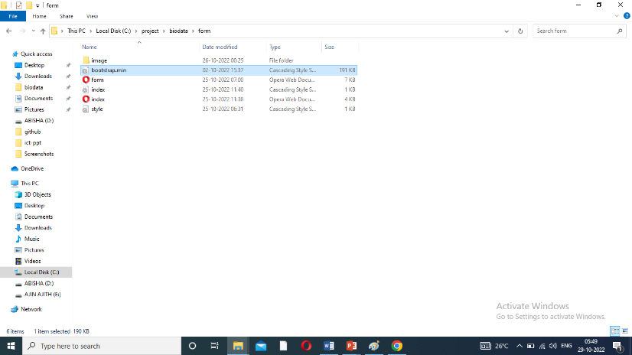
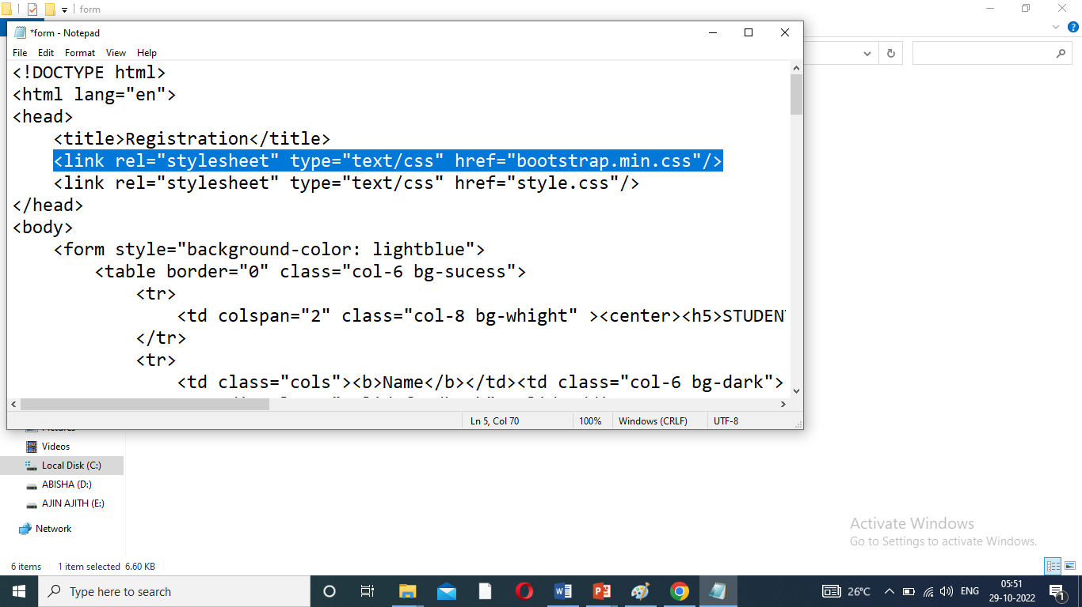
Bootstrapping the HTML webpage process
Step :3
Link to HTML document.
<link rel="stylesheet" type="text/css" href="bootstrap.min.css">

Slide 6
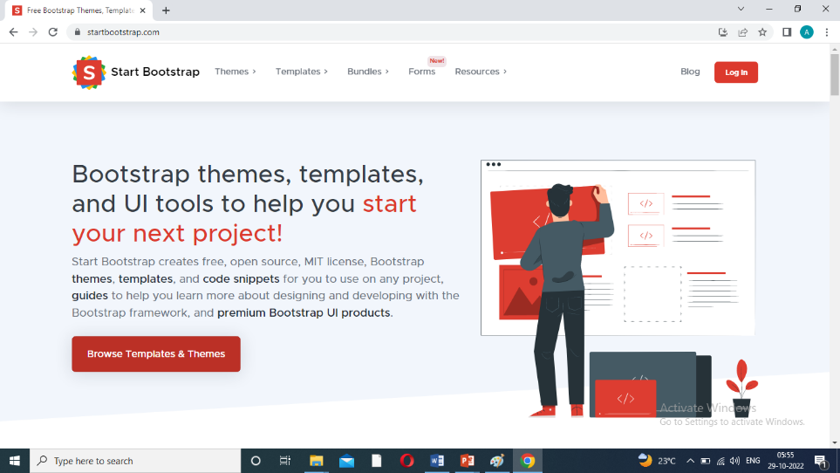
Download templates Step and Use
Download templates Step:
https://startbootstrap.com – Free templates themes – Bootstrap and view source code – free download.

Slide 7
Use
Free and easy-to-use bootstrap theme.
Mobirise Template is a free bootstrap template for any business, portfolio websites or blogs.

Slide 8
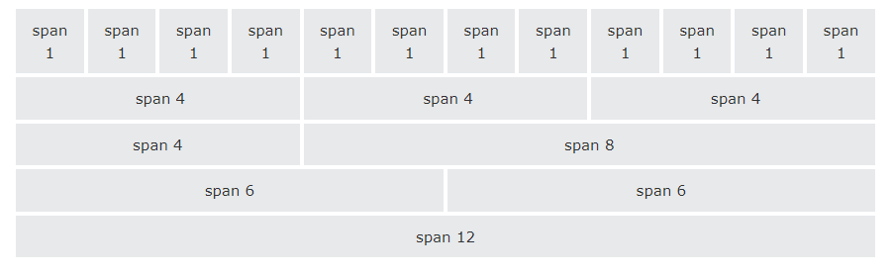
Bootstrap Grid System
Create Table Divide Tag:
Bootstrap's grid system allows up to 12 columns across the page.
If you do not want to use all 12 column individually, you can group the columns together to create wider columns:

Slide 9
Grid rules of table
<div class =``row”>
<div class=``col-sm-2”>Name</div>
<div class=``col-sm-4”><input type=``text” class=``form-control” name=``student-name”/></div>
<div class=``col-sm-6”></div>
Table-striped:_
<table class=``table.table.striped”>
Table-border:_
<table class=``table.table.bordered”>
Table-hover:_
<table class=``sucess”>
<table class=``warning”>
<table class=``active”>

Slide 10
Example code
Login1.html
Save bootstrap. Min.css
<html>
<head>
<title>Form</title>
<link rel="stylesheet" type="text/css" href="login1.css">
<link rel="stylesheet" type="text/css" href="bootstrap.min.css">
</head>
<body>
<form>
<table>

Slide 11
Continue code…
<tr><td colspan="2"><h1>Registration Form</h1></td></tr>
<tr><td><b>First name:</b></td>
<td><input type="text" id="fname" name="fname"></td></tr>
<tr><td><b>Last name:</b></td>
<td><input type="text" id="lname" name="lname"></td></tr>
<tr><td colspan="2"><center><input type="submit" class="btn btn-primary“ value="submit"></center></td></tr>
</table>
</form>
</body>
</html>

